Slide 1
Proof of Concept
For Los Angeles Assessor's Office

Slide 2
Frontend: User Interface
Functionality
Simplicity
Efficient

Slide 3
Tools
PHP v 7.1
CSS3
HTML5
Javascript

Slide 4
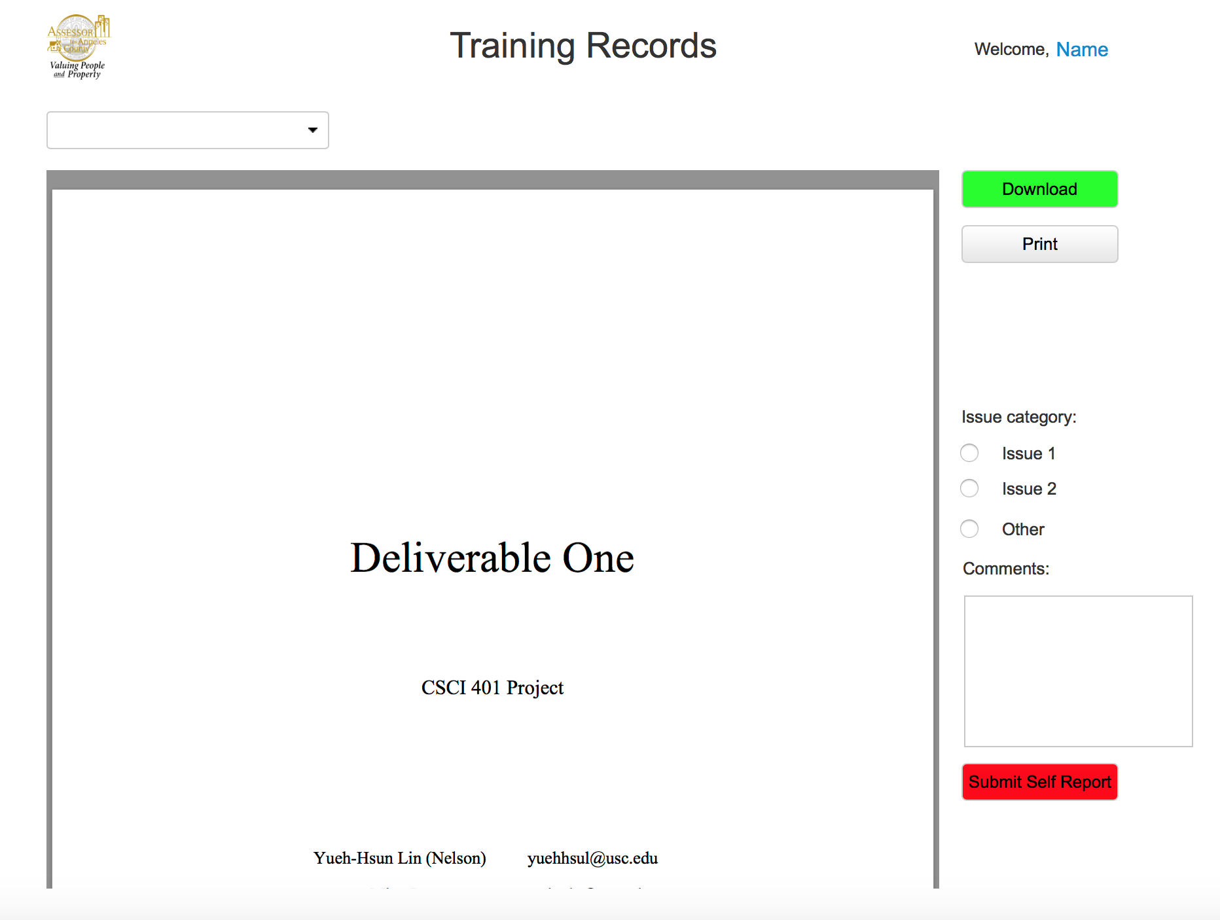

Slide 5
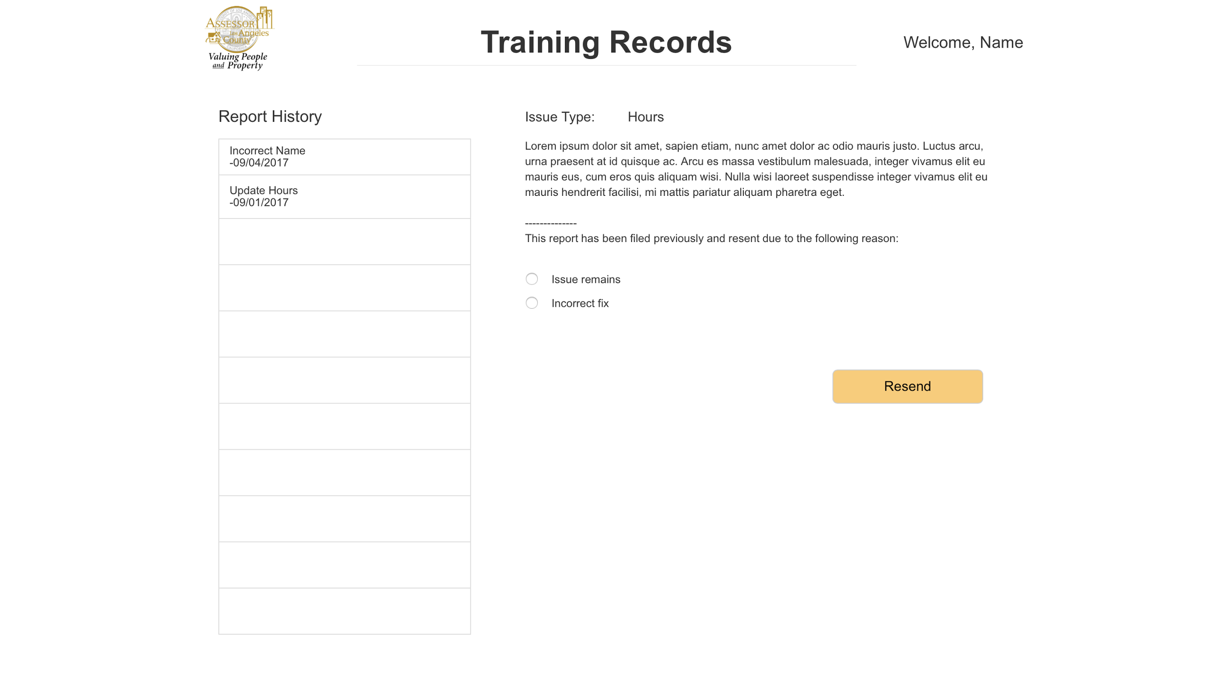

Slide 6
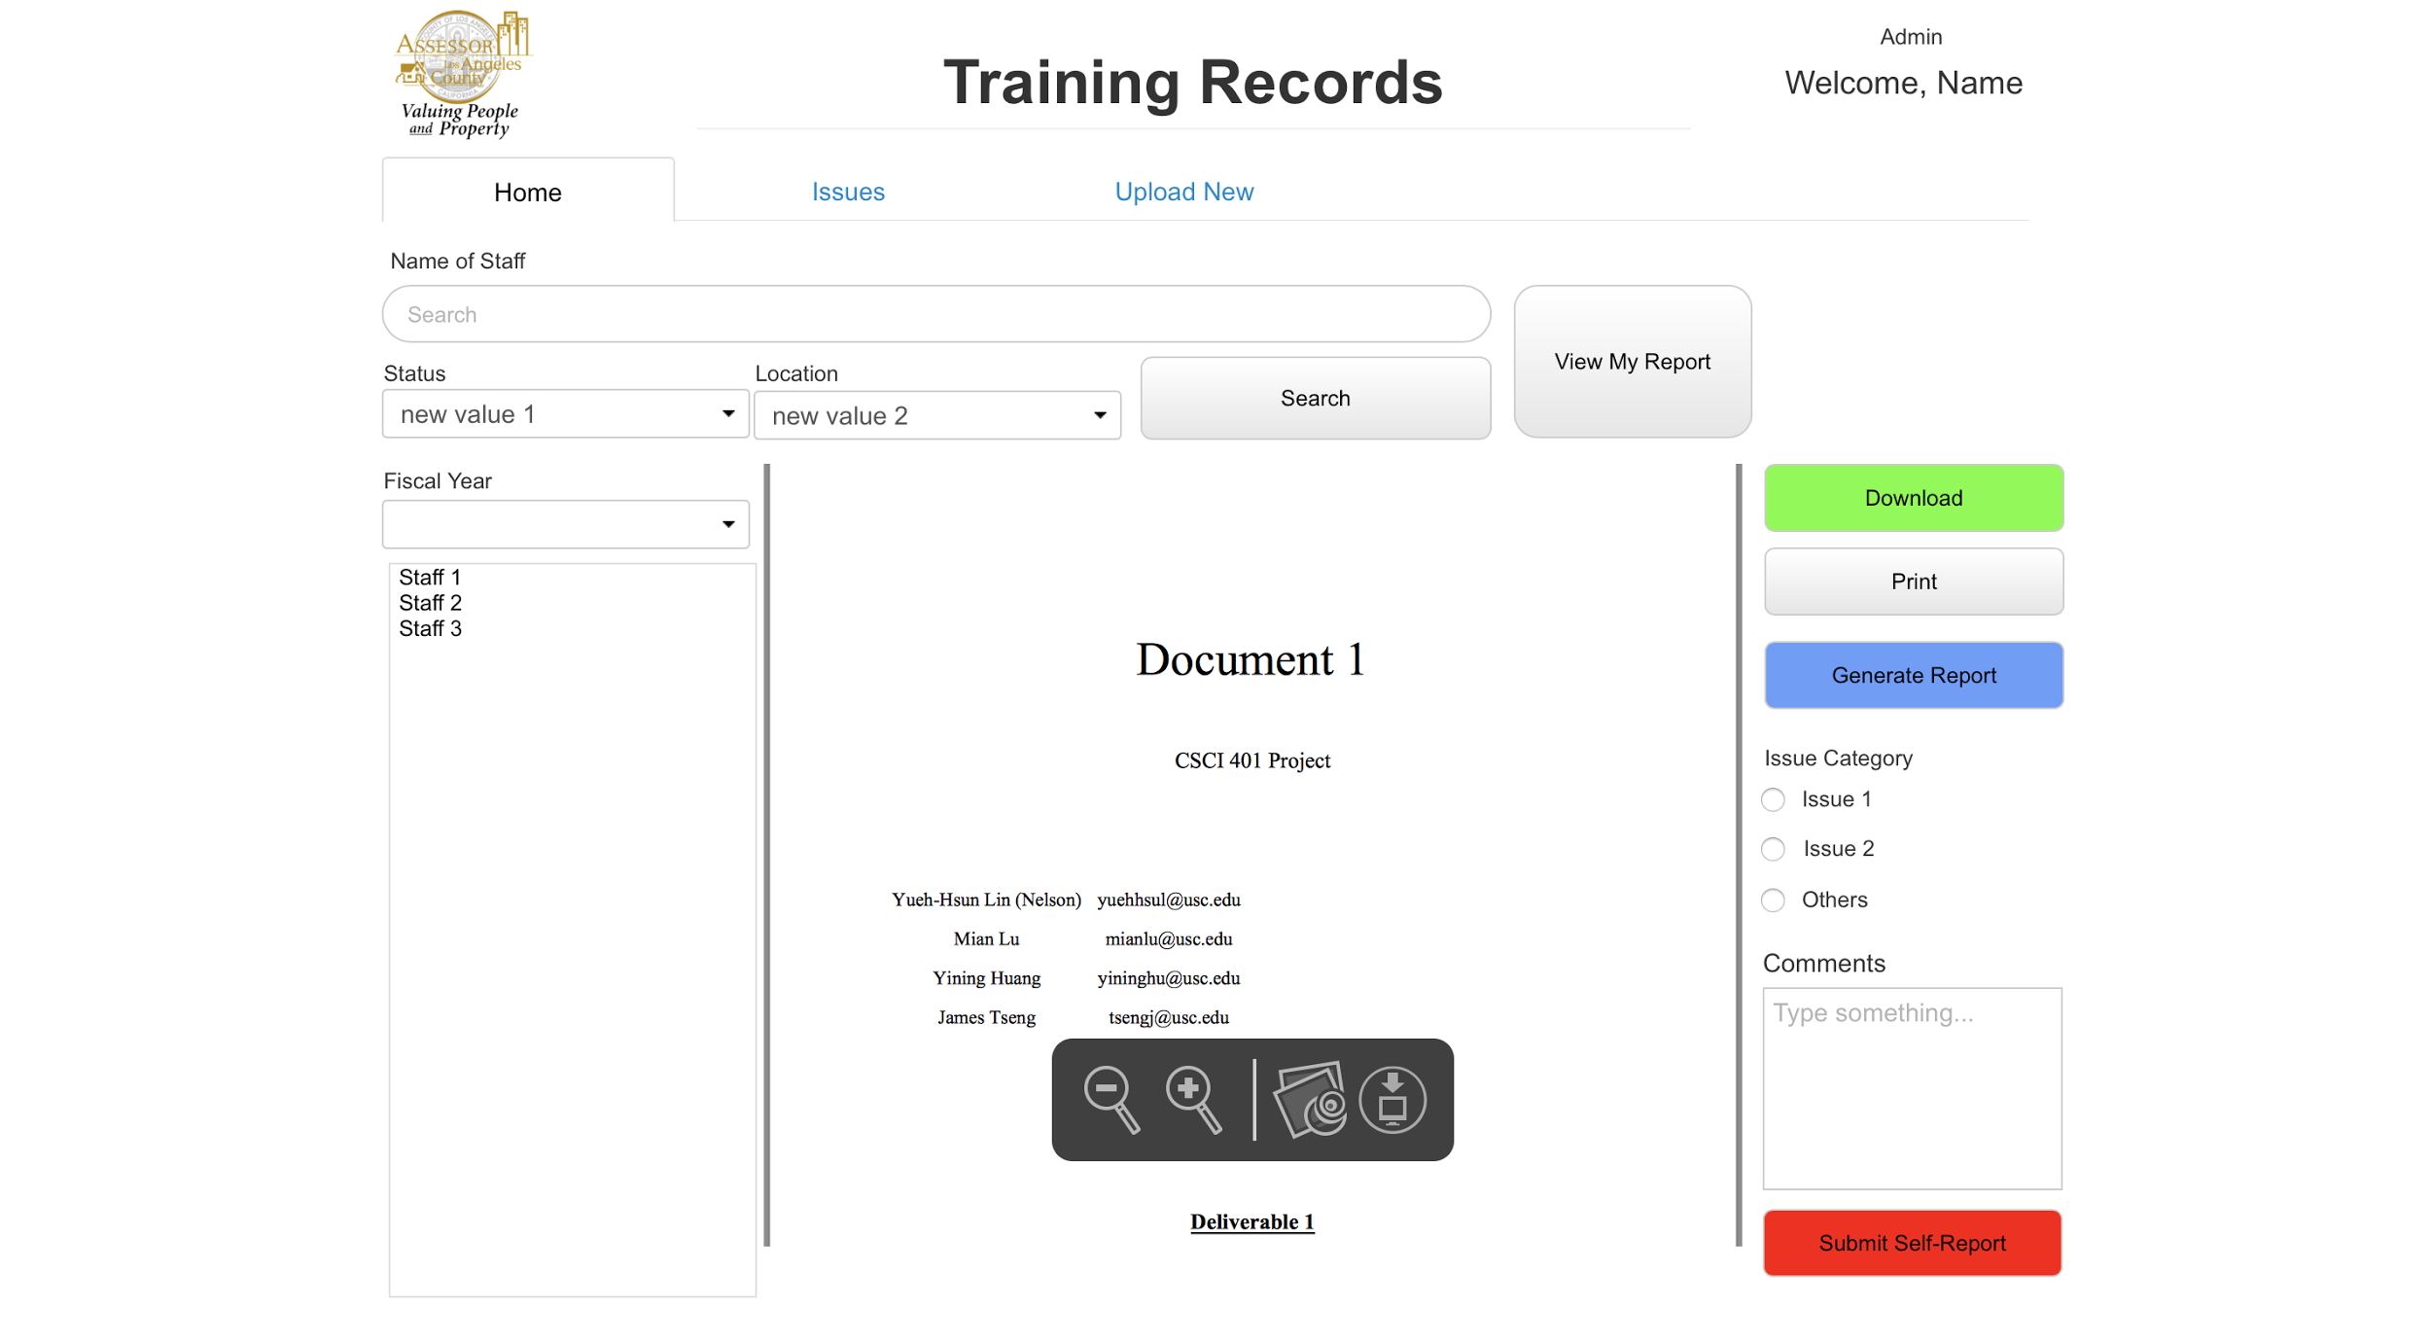

Slide 8
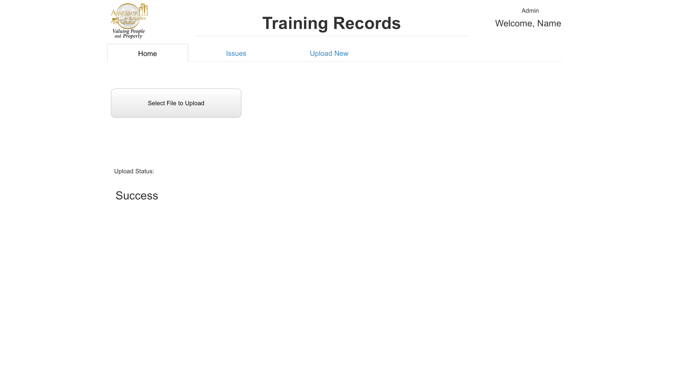

Slide 9
Backend: Data
Migration & Update
Normalization
Structure

Slide 10
Generate PDF report
PHP
FPDF class
Documentation
http://www.fpdf.org/

Slide 11
Mian & Yining: Backend PoC
Identify 4 major aspects our design should accommodate:
1. How to migrate initial MS Access data to MSSQL
2. How to make webapp connect to MSSQL (print pdf; upload mdb; edit records; export database)
3. How to update MSSQL data with monthly BOE mdb
4. How to implement SQL data normalization

Slide 12
Data Migration & Update
Use a third party software (http://www.bullzip.com/products/a2s/info.php)
Security Concerns
Manual conversion MS Access to Excel, Excel to MSSQL
Python

Slide 13
Connection to Database:
Microsoft Drivers for PHP for SQL Server
Open source code available, developed by Microsoft:
https://github.com/Microsoft/msphpsql

Slide 14
Misc: Secondary Storage
Is it needed?

Slide 15
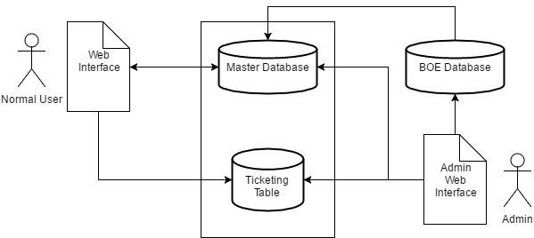
Overview of Database Structure

Slide 16
note:
http://database.ittoolbox.com/groups/technical-functional/access-l/upgrade-to-sql-database-what-front-end-for-multi-users-4986010
Notes:
implement the entire front end as a Web application that is executed within a Web browser. This is an even more complex development environment (you have to develop both the user interface, which is sent to the browser and executed there, and the server-side code that interacts with each Web page or functional block, communicates with the back end, and implements the business rules layer), but the result can be very effective; your users can operate on a wide variety of computer systems, and the distribution of application updates is much simpler.

